Slide 1
Feature selection and dimensionality reduction

Slide 2

Disclaimer: it’s an art!
And I’m just a rookie

Slide 3
Dimensionality reduction
Linear
Unsupervised (PCA, PRPCA, SCPCA, …)
Supervised (LDA, others?)
Non-linear graph based methods
Unsupervised (t-SNE, UMAP)
Supervised (supervised UMAP, others?)
Feature selection
Supervised
Unsupervised

Slide 4
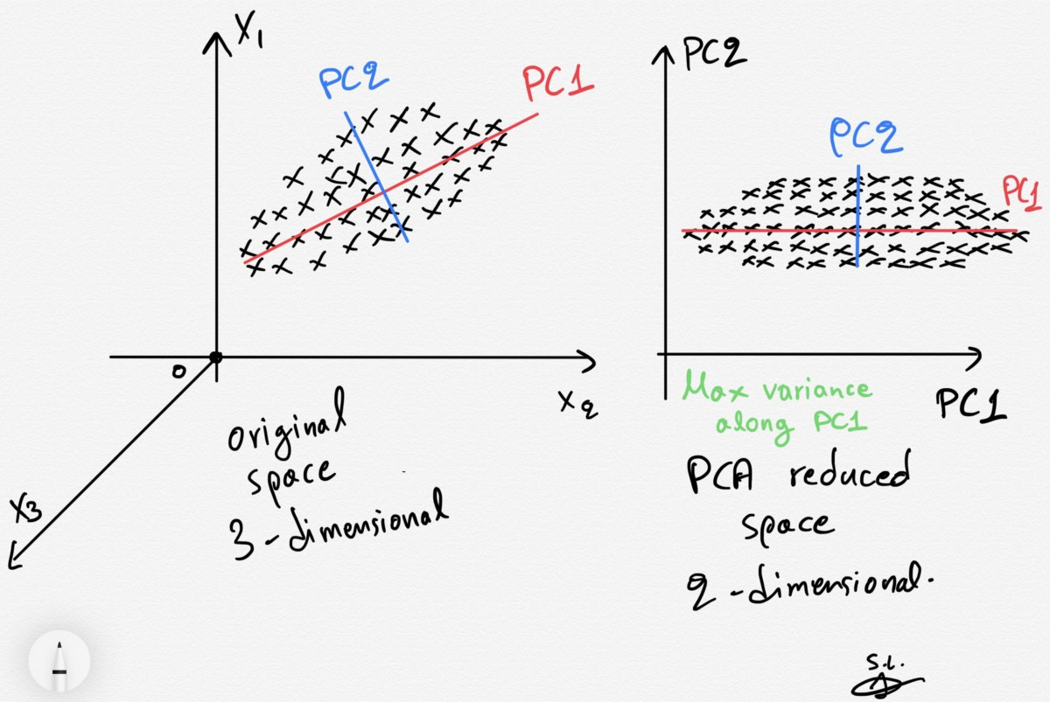
Dimensionality reduction: unsupervised linear
+ Easy to interpret (important for reviewers!)
+ No parameters to tune
+ Axes can be interpreted
+ Deterministic
+ Fast
Assumes gaussian data, so easily skewed by noise + outliers
No regard given to local structure

Slide 5
Dimensionality reduction
Linear
Unsupervised (PCA, PRPCA, SCPCA, …)
Supervised (LDA, others?)
Non-linear graph based methods
Unsupervised (t-SNE, UMAP)
Supervised (supervised UMAP, others?)
Feature selection
Supervised
Unsupervised

Slide 6
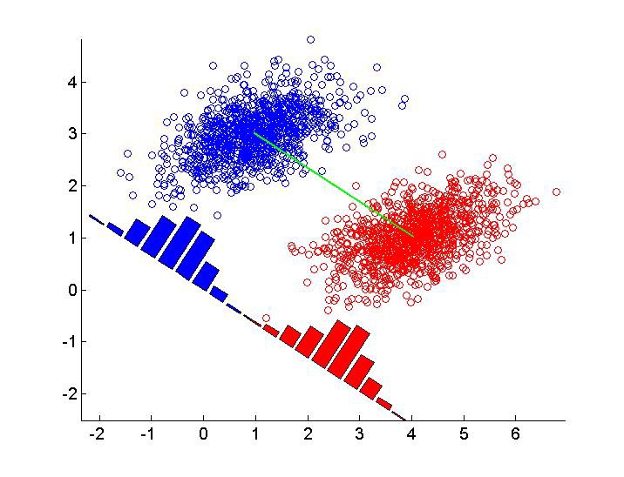
Dimensionality reduction: supervised linear
+ Deterministic
+ No parameters to tune
+ Easy to interpret
+ Fast
Only get (N classes – 1) dimensions
Assumes points are gaussian within each class (I think!)

Slide 7
Dimensionality reduction
Linear
Unsupervised (PCA, PRPCA, SCPCA, …)
Supervised (LDA, others?)
Non-linear graph based methods
Unsupervised (t-SNE, UMAP)
Supervised (supervised UMAP, others?)
Feature selection
Supervised
Unsupervised

Slide 8
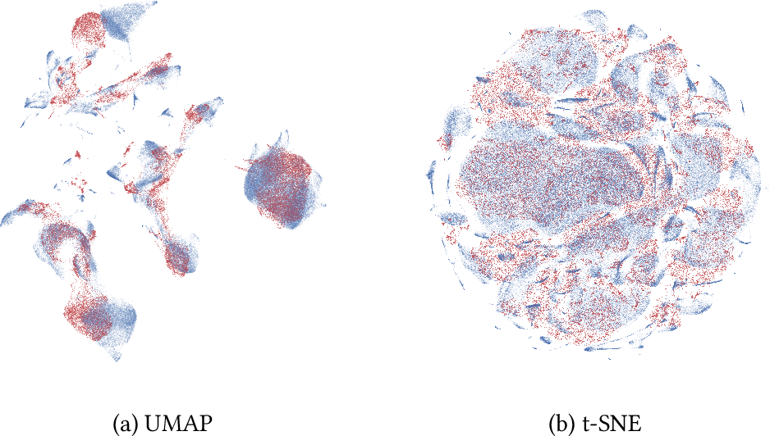
Dimensionality reduction: unsupervised non-linear
+ Very powerful in my experience
+ Spectrum between local and global structure using parameters
Non-deterministic (depends on random seed)
Axes are not easily interpretable
t-SNE can take very long to run (UMAP is faster though)

Slide 9
Dimensionality reduction
Linear
Unsupervised (PCA, PRPCA, SCPCA, …)
Supervised (LDA, others?)
Non-linear graph based methods
Unsupervised (t-SNE, UMAP)
Supervised (supervised UMAP, others?)
Feature selection
Supervised
Unsupervised

Slide 10
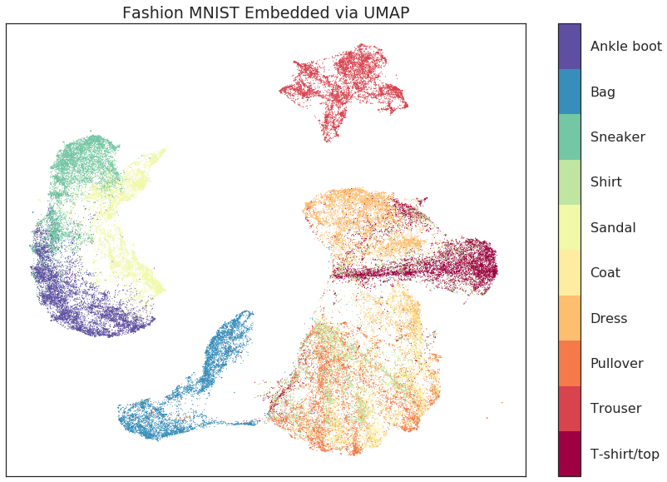
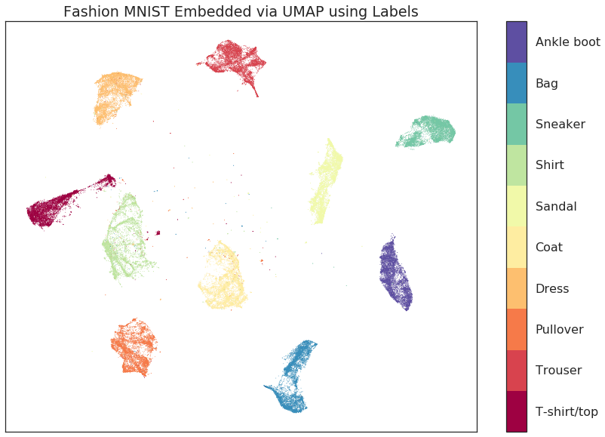
Dimensionality reduction: unsupervised non-linear
I don’t know much about these but generic comments:
+ Seems powerful
Non-deterministic
Easy to overfit to training data

Slide 11
Dimensionality reduction
Linear
Unsupervised (PCA, PRPCA, SCPCA, …)
Supervised (LDA, others?)
Non-linear graph based methods
Unsupervised (t-SNE, UMAP)
Supervised (supervised UMAP, others?)
Feature selection
Unsupervised
Supervised

Slide 12
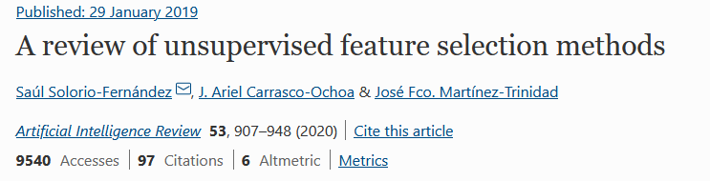
Feature selection: unsupervised
Example strategies:
Find features that align with PCA results (filter method)
Cluster data, use these as pseudo-classes, proceed with supervised feature selection (wrapper method)

Slide 13
Dimensionality reduction
Linear
Unsupervised (PCA, PRPCA, SCPCA, …)
Supervised (LDA, others?)
Non-linear graph based methods
Unsupervised (t-SNE, UMAP)
Supervised (supervised UMAP, others?)
Feature selection
Unsupervised
Supervised

Slide 14
Feature selection: supervised
Example strategies:
Permutation importance:
Build model with all features and assess performance
Shuffle one feature at a time – see how much accuracy is reduced
Greedy forward feature selection:
Compute predictive performance of each feature individually
Start with best feature (1 dimension)
Add second feature (so now 2 dimensions) which improves performance most
Add third feature…
+ Picks best possible combination of features
Very computationally expensive
Can overfit to training data

Slide 15
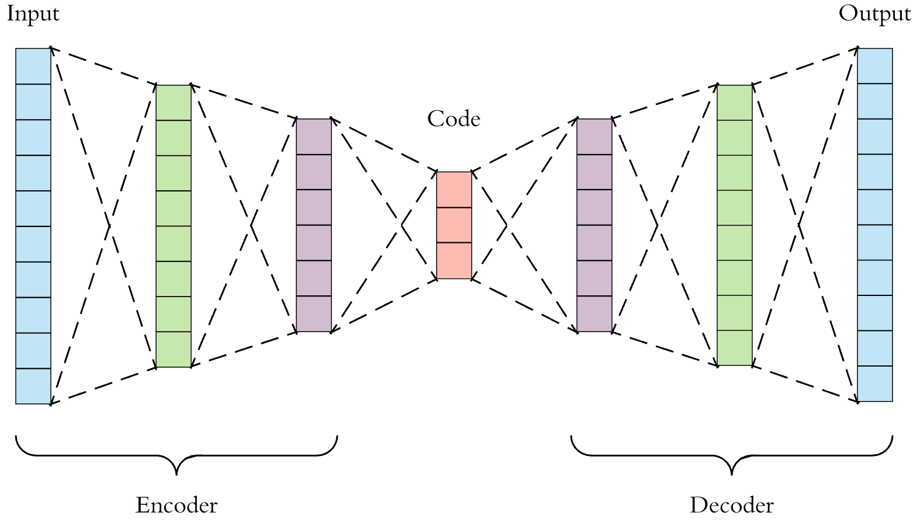
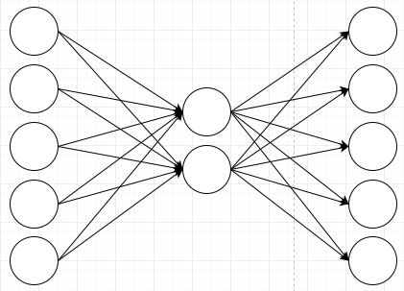
Bonus: neural network models
Linear least squares optimisation
(or with squash functions neural network compression..?)
Autoencoders

